Slide 1
Fence Patrol
Python with Robots Mission 5
Lesson 2 Objectives 3-5

Slide 2

Pre-Mission Warm-Up
In your Mission 5 Lesson 2 log, answer the
pre-mission warm-up questions:
What code reads a line sensor?
What do you remember about functions?

Slide 3
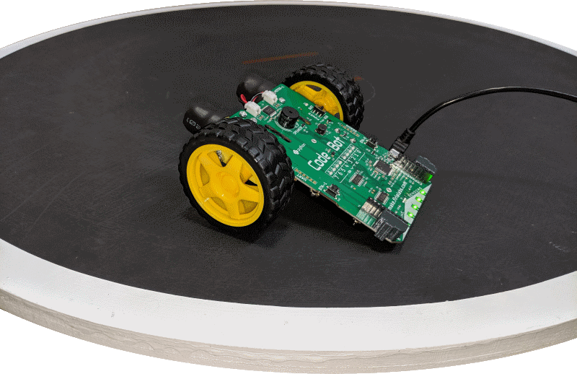
Mission 5: Fence Patrol
In this project, you will learn how to use data from CodeBot’s line sensors.
CodeBot has five line sensors mounted on the front of its board.
The sensors allow CodeBot to interact with its environment.

Slide 4
Mission 5: Fence Patrol
Project goals:
Read the line sensor and display the results on the green LEDs above them.
Use analog readings to measure the contrast between different surfaces.
Make a contact counter to show each line detect on the red User LEDs.
Teach CodeBot to drive between the lines!

Slide 5
Mission 5: Fence Patrol
For this lesson, we will work on the finish the first task and complete the second task:
Read the line sensor and display the results on the green LEDs above them.
Use analog readings to measure the contrast between different surfaces.

Slide 6
Objective #3: Crossing the Line
For this mission, you want to detect a boundary line.
The line will be a dark line (black tape) on a white surface.
If the ‘bot detects the boundary line, you want the code to return True. Otherwise, return False.
You can turn on the LED light above the sensor with this information.
  Detected – True – turn on LED
  Not detected – False – turn off LED

Slide 7
Objective #3: Crossing the Line
The True or False value is a Boolean.
You can assign the Boolean value to a variable.
Then use the variable to turn on/off the LED.
Compare the current reading to a threshold value.
Use a number in the middle range for the threshold.
threshold = 2000
A black line will have a reading much greater than the threshold value, so the if statement will be:
if val > threshold:

Slide 8
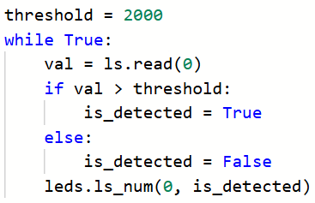
Objective #3: Crossing the Line
Your code could look like this:

Slide 9
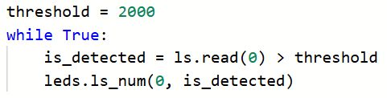
Objective #3: Crossing the Line
But we can combine several lines of code by assigning the Boolean value to the variable directly:

Slide 10
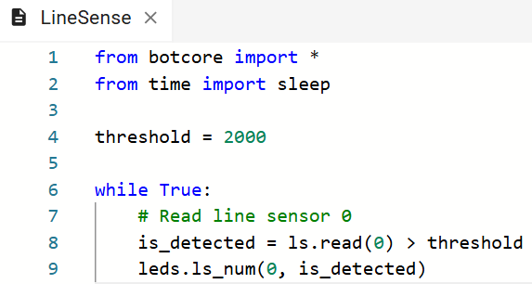
Objective #3 Activity
DO THIS:
Modify your code to look like this:

Slide 11
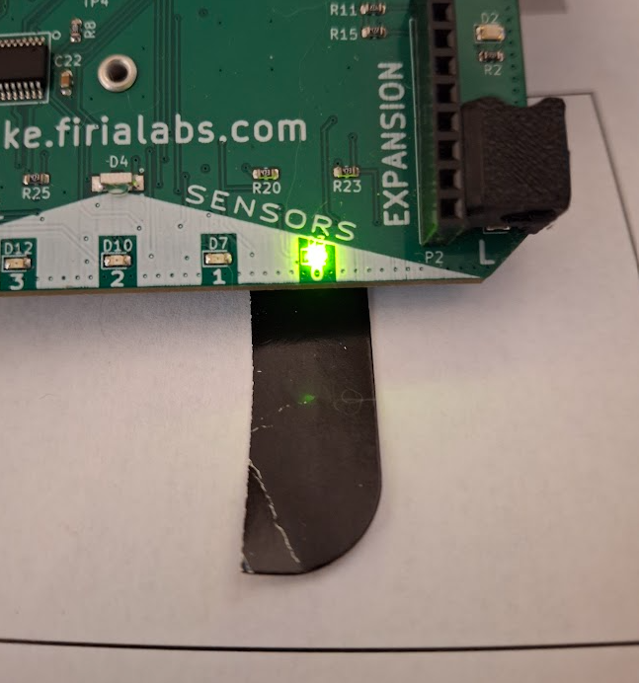
Objective #3 Activity
DO THIS:
Run your program.
Place the ‘bot on the white rectangle from the Test Surface paper.
Put a small black paper under Line Sensor 0 and watch the LED turn on.

Slide 12
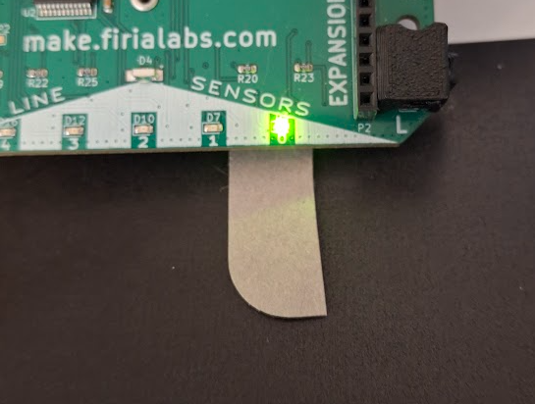
Extension (optional)
Can you detect a white line on a black surface?
Modify your code by changing the condition of the if statement.
Place the ‘bot on the black rectangle of the Test Surface paper.
Test the code.

Slide 13
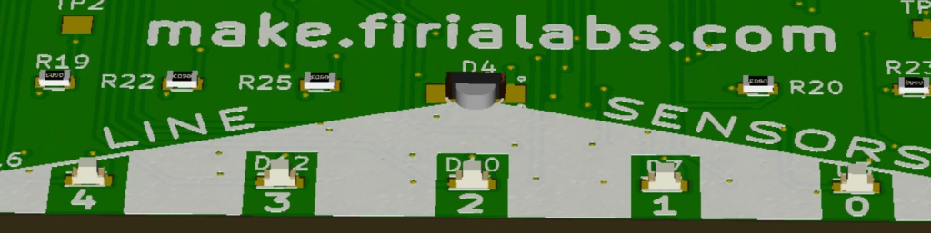
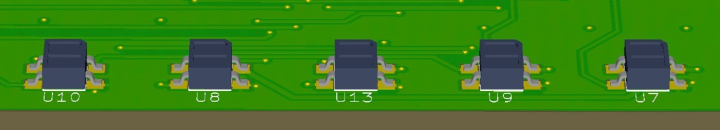
Objective #4: (Fun)ctions
Take a look at the front edge of CodeBot.
Sensors on the bottom.
LEDS on top.
You have line sensor 0 working already. Let’s get the rest of the line sensors to your LED party!

Slide 14
Objective #4: (Fun)ctions
You could do this by just copying and pasting your code.
But …
DRY
Don’t Repeat Yourself

Slide 15
Objective #4: (Fun)ctions
Concept: Don’t Repeat Yourself (DRY)
Here is ancient coding wisdom:
Never write the same code twice.
A little repetition isn’t awful.
But if you type the same code over and over again, and then want to make a change to it, it will take a lot of work to modify it in the future.
Instead, use a programming tool, like a function, to do the work.

Slide 16
Objective #4: (Fun)ctions
Challenge accepted? Excellent!
Take the code you have in the loop.
Make it into a function.
This function will read one line sensor and control its LED.
Use a variable n for the line sensor and LED.
This variable n will be a parameter.
Then call the function in the loop. Use the argument 0 in the function call.
The detect line code will be neatly packaged up!

Slide 17
Objective #4 Activity
DO THIS:
Open the file – LineSense
Modify your code:
  Define a function for detecting a line
  Include a parameter n.
  Use the n variable for the line sensor and LED
  Call the function in the loop
  Use 0 as the argument in the function call

Slide 18
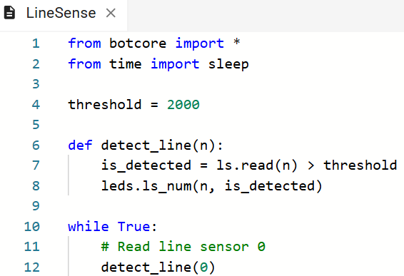
Objective #4 Activity
DO THIS:

Slide 19
Objective #4 Activity
DO THIS:
Run your program. It should work exactly the same as Objective 3.
Place the ‘bot on the white rectangle from the Test Surface paper.
Put a small black paper under Line Sensor 0 and watch the LED turn on.

Slide 20
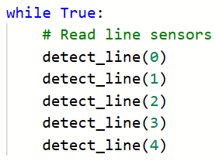
Objective #5: Line Sensor Magic Lights!
Your next step is to scan all the sensors.
Are you thinking something like this?

Slide 21
Objective #5: Line Sensor Magic Lights!
Not so fast!
That is a lot of repetition. Not very DRY!
You know how to make a loop to count from 0 to 4.
And you can package it in a new function.
Then you can scan all the line sensors with one line of code – a function call!

Slide 22
Objective #5 Activity
DO THIS:
Define another function to read all the line sensors using a loop.
Name the function scan_lines()
Use the variable n as the control variable
Start a while loop that will repeat 5 times
In the loop
  Call the detect_lines function
  Increment n

Slide 23
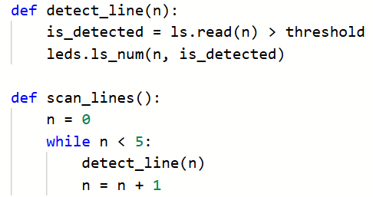
Objective #5 Activity
DO THIS:

Slide 24

Objective #5 Activity
DO THIS:
In the main program’s while loop, call the new function.

Slide 25
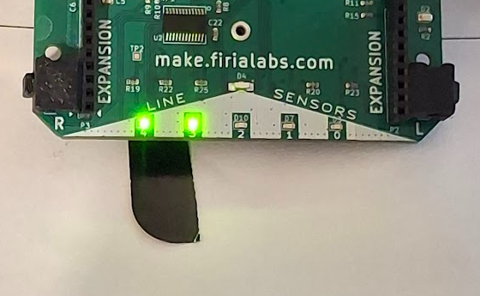
Objective #5 Activity
DO THIS:
Run your program.
Place the ‘bot on the white rectangle from the Test Surface paper.
Put a small black paper under each line sensor, one at a time, and watch the LED turn on.

Slide 26

Mission quiz
Now …. time for a quiz!
Answer the three quiz questions in CodeSpace.
CODEX
QUIZ

Slide 27
Extensions
Here are some things to try:
The loop starts reading the line sensor on the right and moves to the left. Change the loop to start at the left and sweep to the left.
Play a tone when an LED turns on. For an additional challenge, change the tone for each LED.

Slide 28
Post-Mission Reflection
Complete the post-mission reflection in your Mission 5 Lesson 2 Log:
Why do programmers use functions in their code?

